Slide 1


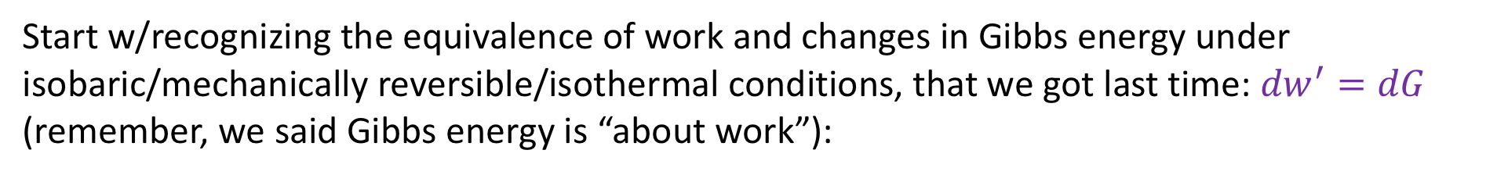
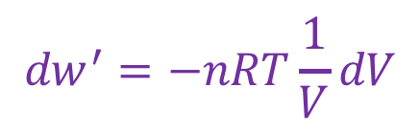


For the curious: Justifying the form of concentration work
Start w/recognizing the equivalence of work and changes in Gibbs energy under isobaric/mechanically reversible/isothermal conditions, that we got last time: ${dw}^{′}=dG$ (remember, we said Gibbs energy is “about work”):
Using the definition G=H-TS, isothermal
Differential eq. of state for entropy of ideal gas
Ideal gas/solute
$${dw}^{′}=−nRT\frac{1}{V}dV$$
$${dw}^{′}=dG$$
$${dw}^{′}=dH−TdS$$
$${dw}^{′}=−TdS$$
$${dw}^{′}=nRT\frac{1}{c}dc$$
which obviously bears a close resemblance to
${dw}^{′}=nRT\frac{1}{c}\frac{dc}{dε}dε$

Slide 2


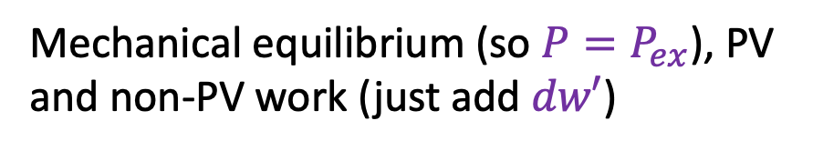
Enthalpy, q, and PV+non-PV work
$$H = U+PV$$
Total differential, product rule
$$dH =dU+PdV+VdP$$
Isobaric, 1st Law
$$dH =dq−P_{ex}dV+dw′+PdV$$
Mechanical equilibrium (so $P=P_{ex}$), PV and non-PV work (just add $dw′$)
$$dH =dq+dw′$$

Slide 3



Gibbs energy and non-PV work (solution)
Now let’s get $dG$ when there is non-PV work. Assume everything you assumed for $dH$ (including possibility of non-PV work); on top of all that, you should assume isothermal conditions.
$$G =H−TS$$
Total differential, product rule, isothermal
$$dG =dH−TdS$$
$dH =dq+dw′$ (isobaric, 1st Law)
$$dG =dq+dw′−TdS$$
Thermodynamic definition of entropy
$$dG =dw′$$

Slide 4

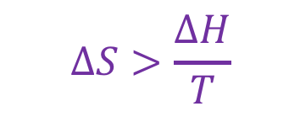
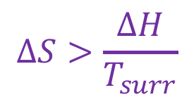
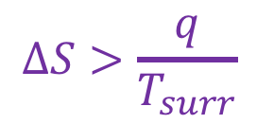

Putting it all together: $∆G<0$ as a condition of spontaneity at constant T and P (solution)
Isobaric/mechanically reversible
Isothermal
Rearranging
G=H-TS
$$∆S>\frac{q}{T_{surr}}$$
$$∆S>\frac{∆H}{T_{surr}}$$
$$∆S>\frac{∆H}{T}$$
$$∆H−T∆S<0$$
$$∆G<0$$

